Slide 1

Hiring Process Analytics
By: Rajat Panwan

Slide 2
This project is about performing exploratory data analysis on a dataset provided by a company for their hiring process. As a lead data analyst, the task is to analyze the data to draw insights and provide recommendations to the hiring department. The project will involve understanding the data columns, checking for missing data, clubbing columns with multiple categories, checking for outliers, removing outliers, and drawing data summaries. The analysis will be performed using Excel or Google Sheets.
Project Description

Slide 3

Approach:
The first step in the project was to download the dataset provided by the Trainity and understand the data columns and data. This involved checking the format of the data, identifying the variables, and understanding the range of values for each variable. The next step was to check for missing data. After that, I checked for outliers and removed them using statistical methods. I then drew data summaries and analyzed the data to draw insights and provide recommendations.

Slide 4

Tech-Stack Used:
The analysis was performed using Microsoft Excel. We used different Excel functions, such as COUNT, COUNTIFS, SUM, UNIQUE and AVERAGE to perform the analysis. We also used PIVOT TABLE, SLICER in Pivot Table, CHARTS and GRAPHS to visualize the data.

Slide 5

Insights:
The analysis of the dataset provided insights into the hiring process of the company. I found that the company had hired more males than females. The average salary offered by the company was found to be ₹49885. I drew the class intervals for salary and found that the salary is equally distributed between ₹1000 to ₹100000. The pie chart graph showed that most of the employees were working in the Operations department, followed by the Service department. We also represented different post tiers using a chart and found that most of the employees were in C5 and C9 position.

Slide 6

Result:
Excel analysis and summery are on next pages.

Slide 7
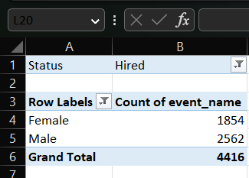
A. Hiring
Process of intaking of people into an organization for different kinds of positions.
Your task: How many males and females are Hired?

Slide 8
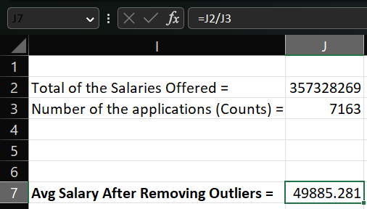
B. Average Salary
Adding all the salaries for a select group of employees and then dividing the sum by the number of employees in the group.
Your task: What is the average salary offered in this company?

Slide 9
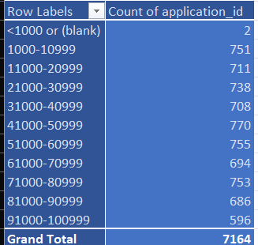
C. Class Intervals
The class interval is the difference between the upper class limit and the lower class limit.
Your task: Draw the class intervals for salary in the company ?

Slide 10
D. Charts and Plots
This is one of the most important part of analysis to visualize the data.
Your task: Draw Pie Chart / Bar Graph ( or any other graph ) to show proportion of people working different department?

Slide 11
E. Charts
Use different charts and graphs to perform the task representing the data.
Your task: Represent different post tiers using chart/graph?

Slide 12

Thank You
Prepared By: Rajat Panwan
You can connect me on:
rajatpawan@gmail.com

